Slide 1
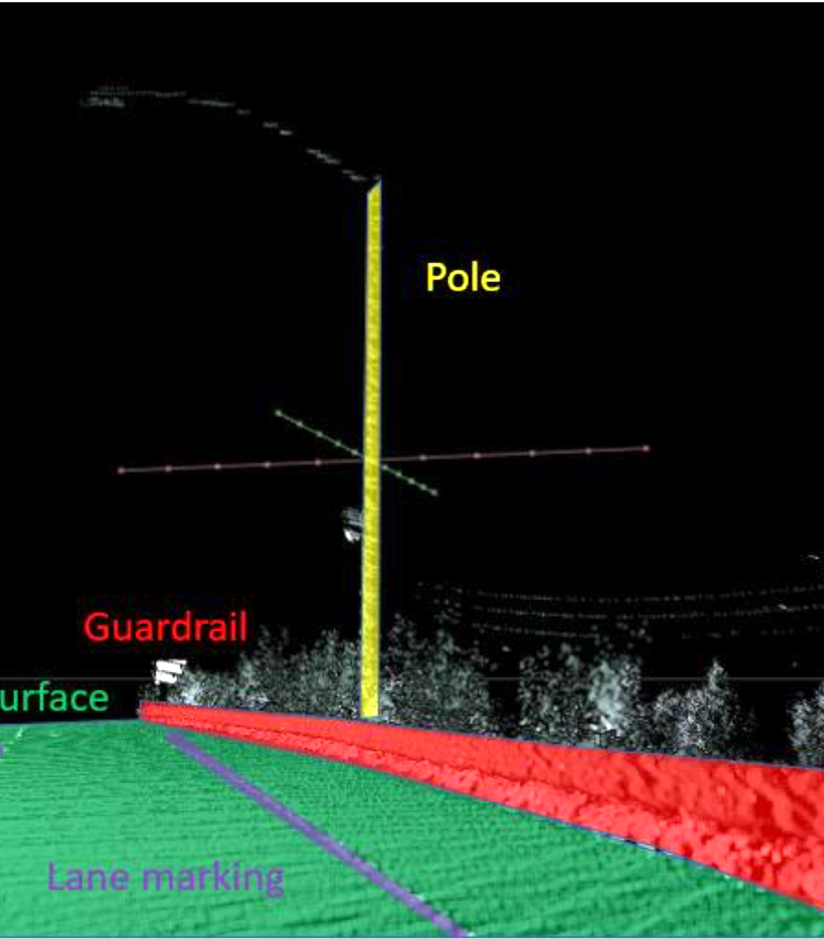
Object detection in PointCloud: road boundary
Final project #6
Yanbo Deng
Ruhui Shen
Rui Zou

Slide 2
Content
Introduction
Coordinates Transformation
Detection Method
Future Work

Slide 3

Introduction
Our Goal: Find the road boundary from the given point cloud
Visualize the point cloud
Detect the boundary (guardrail-curb combination in this case) and extract them.
Method: detect with shape features and global properties (topology and smoothness).
Difference of normal
Density-base Clustering (future work)

Slide 4
Environment
Python:
Coordinate Transformation
C++, PCL, OpenCV:
Boundary Detection

Slide 5
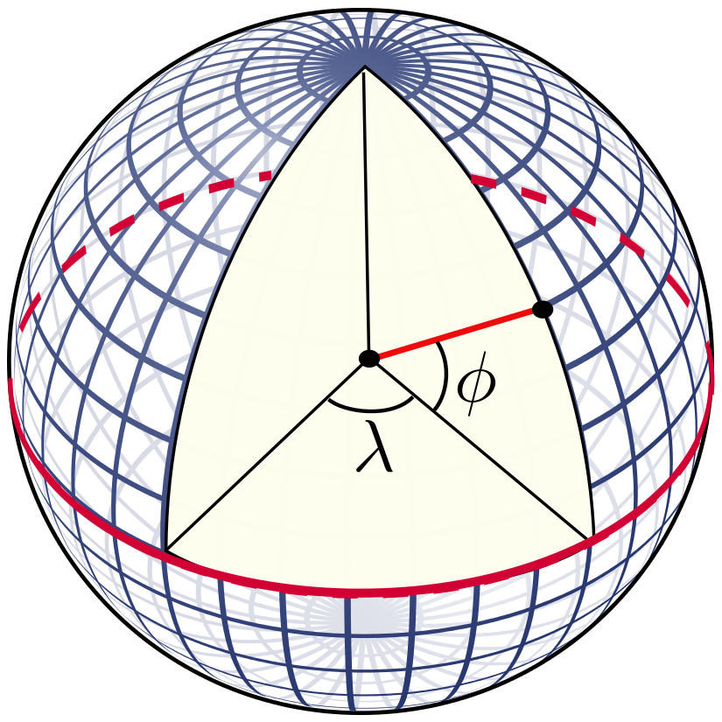
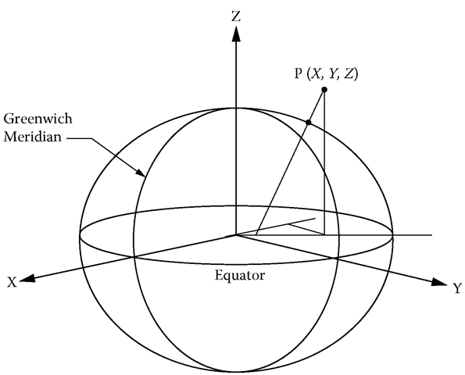
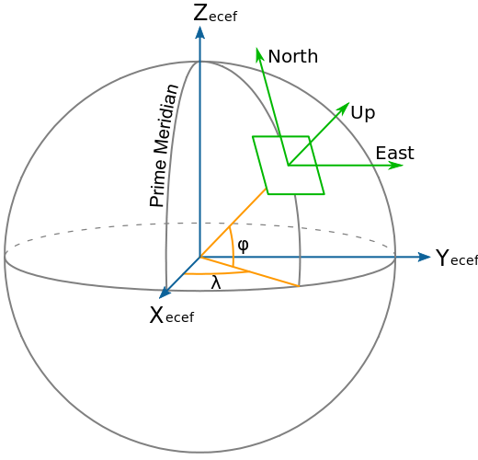
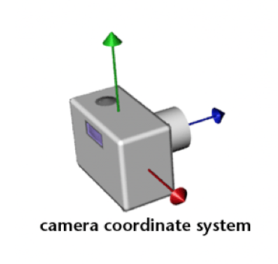
Coordinate Transformations
LLA
ECEF
ENU
Camera
Notes:
Lat-Lon-Alt -> Earth-Centered-Earth-Fixed -> East North Up -> Camera Coordinate

Slide 6
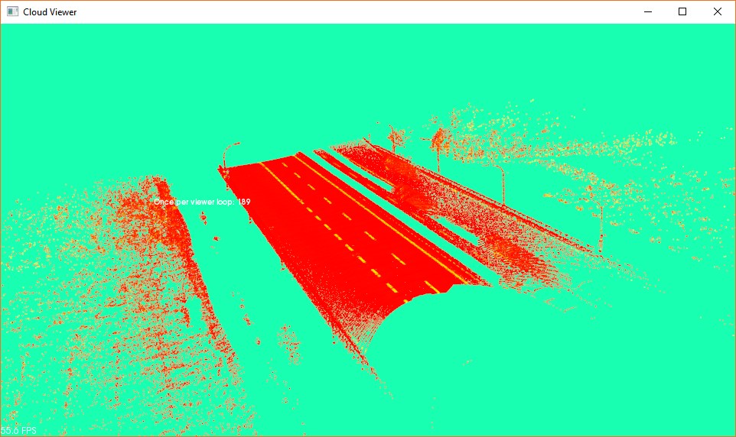
Boundary Detection
Features of road boundary:
Continuity ---- can be clustered
Distinctive from road ---- high curvature
Large ---- lots of points in the cloud
Original PointCloud Data

Slide 7
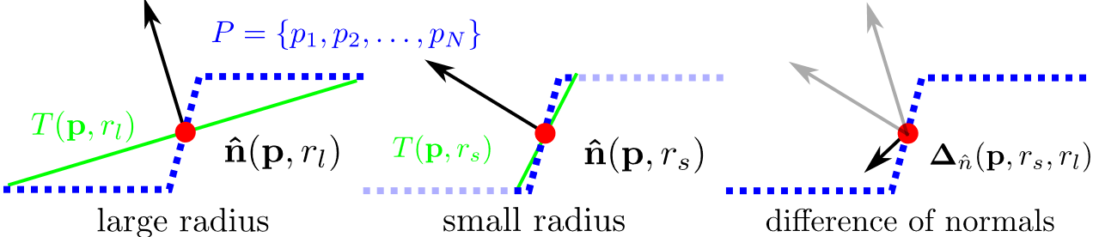
Difference of Normal (DoN)

Slide 8
DON Filtering
Guardrail has different DoN feature than other objects
High curvature: large magnitude of DoN
Similarity: DoN magnitudes of boundary points are similar
Road surface remover
Road surface is the major part of the point cloud
Use RANSAC to find the largest plane and remove it
It is good for clustering and computation cost reduction

Slide 9
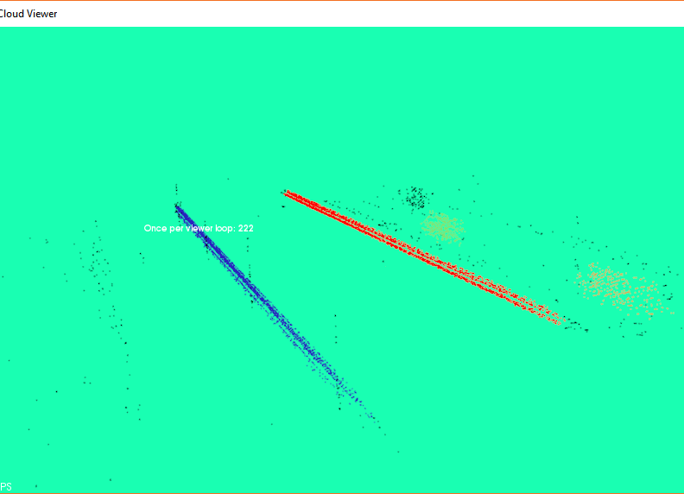
Clustering Criteria
Euclidean Distance: 6 cm
We use Euclidean distance as the proximity measure to assign points to each cluster
Magnitude of DoN (curvature): +-0.2
Points should have similar magnitude of DoN in one cluster

Slide 10
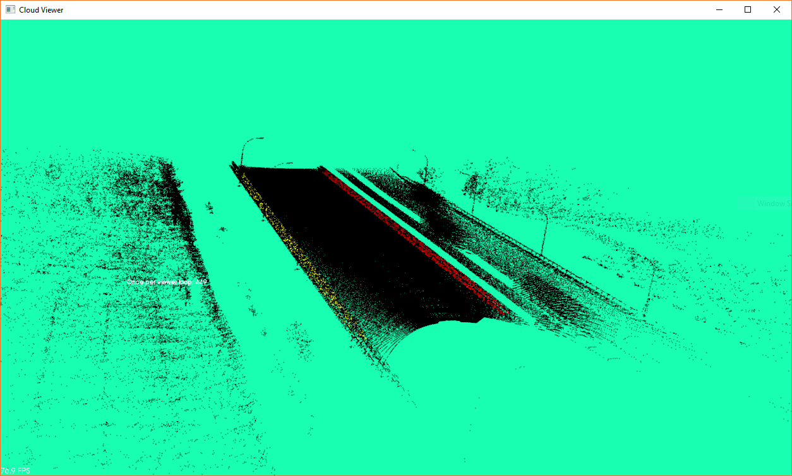
Final Result

Slide 11
Future work
Compress/Project the point cloud data to the undersurface, forming a 2-D image.
Count the number of points in each pixel and record the points.
Use Density-based Clustering Algorithm, e.g. DBSCAN to identify the top dense cluster as possible road boundaries.
Recover the points that belong to road boundaries and mark them out.

Slide 12
Thank you !

